Slide 1
Android: SQLite
Lab 5
2017-2018

Slide 2
Agenda
SQLite
SQLiteOpenHelper
SQLiteDatabase
Cursor
Movies Example
Notes:
Gradle in android studio:
http://stackoverflow.com/questions/16754643/what-is-gradle-in-android-studio
http://developer.android.com/tools/building/configuring-gradle.html

Slide 3
SQLite
SQLite is an Open Source Database which is embedded into Android.
SQLite is available on every Android device. Using an SQLite database in Android does not require any database setup or administration.
Notes:
SQLite dataTypes: https://www.sqlite.org/datatype3.html
Text
Integer
Numeric
Real
None

Slide 4
SQLiteOpenHelper
SQLiteOpenHelper is the helper class provided by android to create and maintain databases for your application.
This class takes care of opening the database if it exists, create it if it does not exist, and upgrade it as necessary.
In this class you need to override the methods onCreate() to create the database and onUpgrade() to upgrade the database in case of changes in the database schema.

Slide 5
SQLiteOpenHelper Cont’
SQLiteOpenHelper provides the methods getReadableDatabase() and getWriteableDatabase() to get access to an SQLiteDatabase object which allows database access either in read or write mode.

Slide 6
SQLiteDatabase
SQLiteDatabase is the base class for working with a SQLite database in Android.
SQLiteDatabase provides:
insert(), update() and delete() methods.
execSQL() method, which allows to execute an SQL statement directly.
The object ContentValues allows to define key/values.
The "key" represents the table column identifier
The "value" represents the content for the table record in this column.
ContentValues can be used for inserts and updates of database entries.
Queries can be created via the rawQuery() and query() methods
rawQuery() directly accepts an SQL select statement as input.
query() provides a structured interface for specifying the SQL query.
Notes:
and provides methods to open, query and update database .

Slide 7
Cursor
A Cursor represents the result of a query and basically points to one row of the database.
Notes:
A query returns a Cursor object.

Slide 8
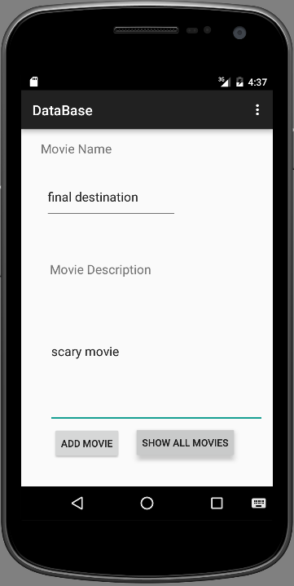
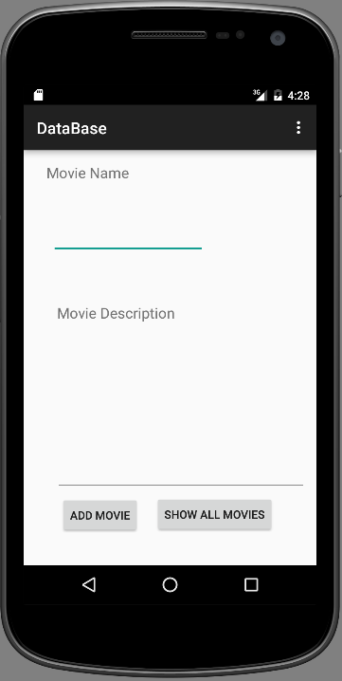
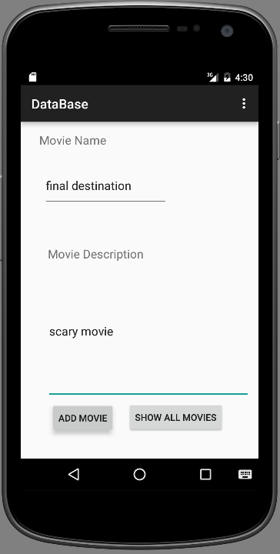
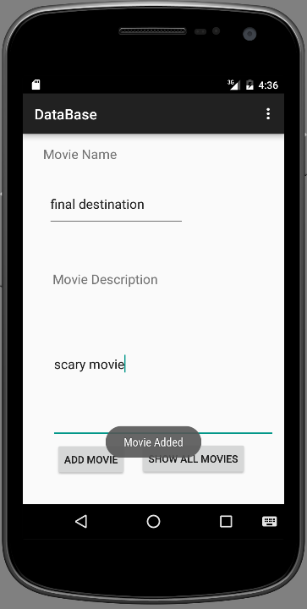
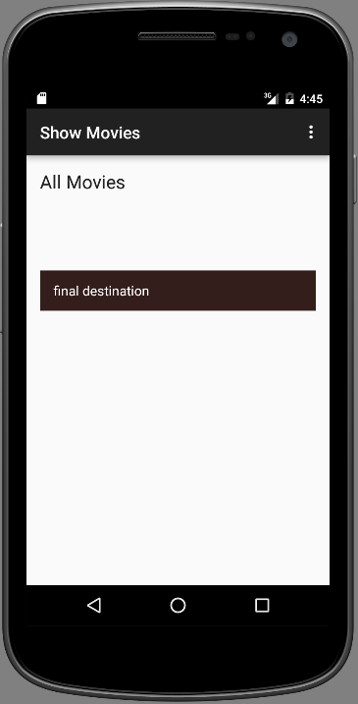
Movies Example GUI

Slide 9
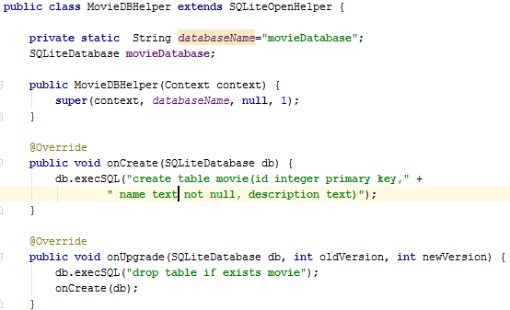
DatabaseHelper Class
Extends SQLiteOpenHelper Class
Specify DB name
Create object from SQliteDatabase
Create the constructor
Override the onCreate method that executes the DB creation Statement
Override the onUpgrade method
9
Notes:
http://developer.android.com/reference/android/database/sqlite/SQLiteOpenHelper.html
onCreate() is called by the framework, if the database does not exists.
onUpgrade() is called, if the database version is increased in your application code. This method allows you to update the database schema.
Both methods receive an SQLiteDatabase object as parameter which represents the database.
SQLite supports the data types TEXT (similar to String in Java), INTEGER (similar to long in Java), Blob: Array of binary data (bytes) and REAL (similar to double in Java). All other types must be converted into one of these fields before saving them in the database.
Why static DBName? this happens because Instance Variables are created once its constructor is called but here in this case before the child's constructor its parent Constructor gets executed.. which means instance variables/object of child class doesn't exist in the Heap. or in other words they are not constructed yet.. but in case of static variables they are first one's getting executed thus they have some values and that works perfectly fine..
cursorFactory: The reason of passing null is you want the standard SQLiteCursor behaviour. If you want to implement a specialized Cursor you can get it by extending the Cursor class( this is for doing additional operations on the query results). And in these cases, you can use the CursorFactory class to return an instance of your Cursor implementation.
When does onCreate() upgrade() methods call?
SQLiteOpenHelper onCreate() and onUpgrade() callbacks are invoked when the database is actually opened, for example by a call to getWritableDatabase() or getReadableDatabase(). The database is not opened when the database helper object itself is created.
SQLiteOpenHelper versions the database files. The version number is the int argument passed to the constructor. In the database file, the version number is stored in PRAGMA user_version. onCreate() is only run when the database file did not exist and was just created.
onUpgrade() is only called when the database file exists but the stored version number is lower than requested in constructor. The onUpgrade() should update the table schema to the requested version.
Primary key auto increment:
http://stackoverflow.com/questions/4388459/how-to-make-auto-increment-on-android-sqlite-database

Slide 10
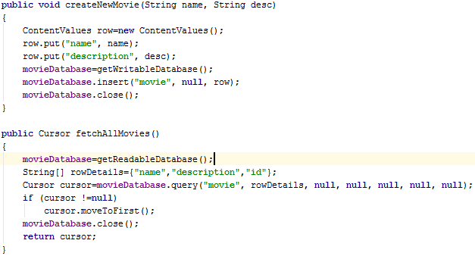
DatabaseHelper Class Cont’
Create a new row Object using ContentValues
Adding columns to the row “Name and Desc”
initialize database object to update database
Insert that row to the DB
initialize database object to update database
Define Cursor that will hold returned rows
Define columns returned in each row
If there are rows in cursor , let it point to the first row
Notes:
http://developer.android.com/reference/android/database/sqlite/SQLiteDatabase.html
We use public long insert (String table, String nullColumnHack, ContentValues values) API to create a new row into the table.
ContentValues a (key,value) pair is the actual row detail. Key is the column name and value is the column value.
We use public Cursor query(String table, String[] columns, String selection, String[] selectionArgs, String groupBy, String having, String orderBy) API to query/read all rows from the table.
We use public int delete (String table, String whereClause, String[] whereArgs) API to delete a row from the table.
We use public int update (String table, ContentValues values, String whereClause, String[] whereArgs)API to update/edit a row in the table.
nullColumnHack: Let's suppose you have a table named foo where all columns either allow NULL values or have defaults.
In some SQL implementations, this would be valid SQL:
`INSERT INTO `foo;That's not valid in SQLite. You have to have at least one column specified:
INSERT INTO foo (somecol) VALUES (NULL);Hence, in the case where you pass an empty ContentValues to insert(), Android and SQLite need some column that is safe to assign NULL to.
selectionArgs:
String[] args = { "first string", "second@string.com" };
Cursor cursor = db.query("TABLE_NAME", null, "name=? AND email=?", args, null);

Slide 11
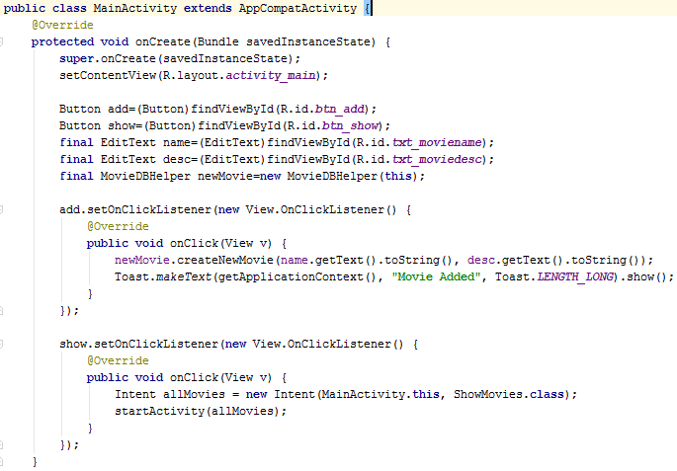
MainActivity
Get All the Views
Create MovieDatabaseHelper Object
Get texts and create new movie
Add actionListener to add_btn
11

Slide 12
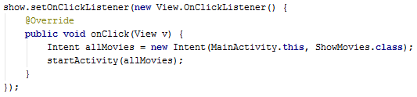
Main Activity Cont’
Add actionListener to gettAllMovies_btn
Define the intent and start activity

Slide 13
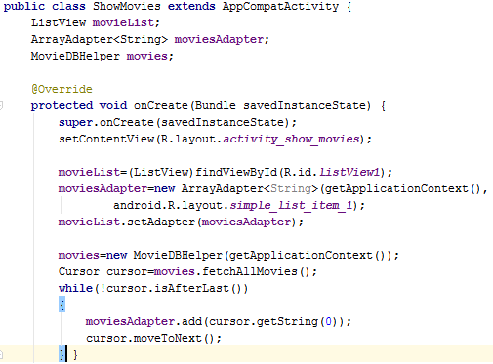
ShowMovies Activity
Global Variables
Get ListView and Set its Adapter
Create MovieDatabaseHelper Object
Create cursor object to point to fetched movies
Get the movie name and add it to the ArrayAdapter then move to the next movie

Slide 14

Practice
30 Minutes
Implement a getMovieDesc method in the MovieDBHelper class which takes movie name and returns its description using rawQuery Method.
Add a textView in the ShowMovies activity
When the user clicks on an item in the listView write its description in the textView

Slide 15
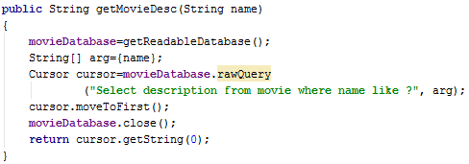
Solution DatabaseHelper Class
Get movie Desc using movie name

Slide 16
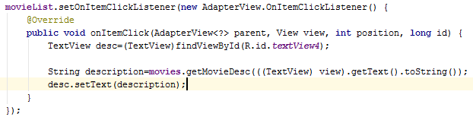
Solution ShowMovies Activity

Slide 17
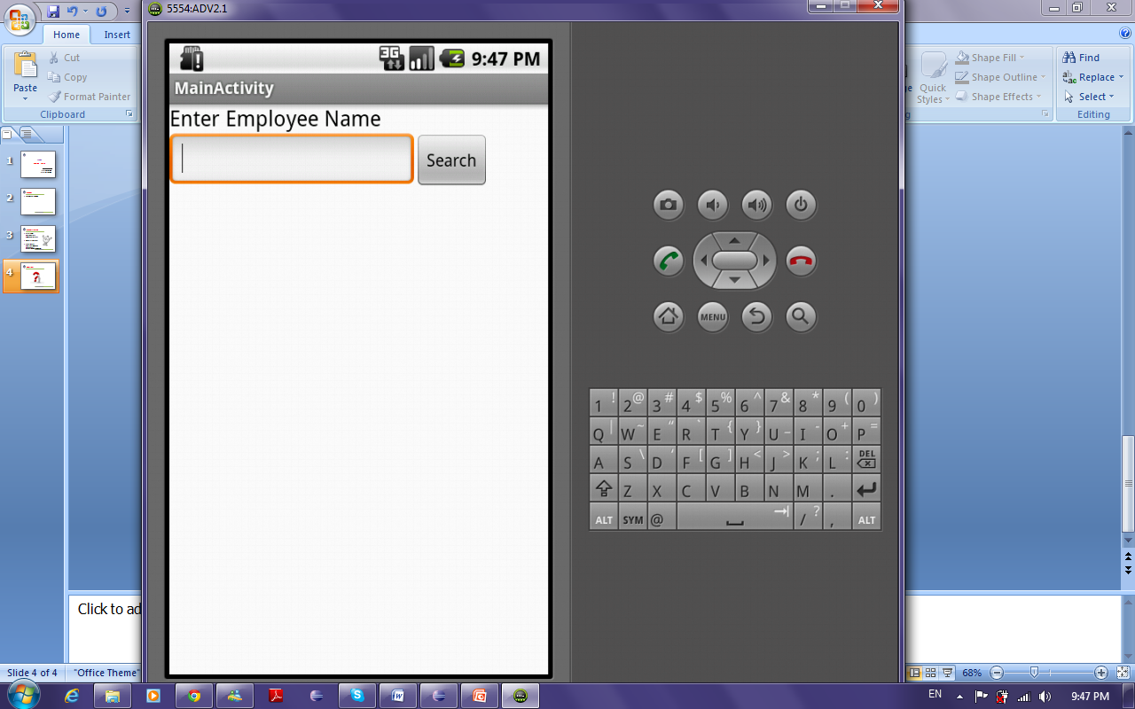
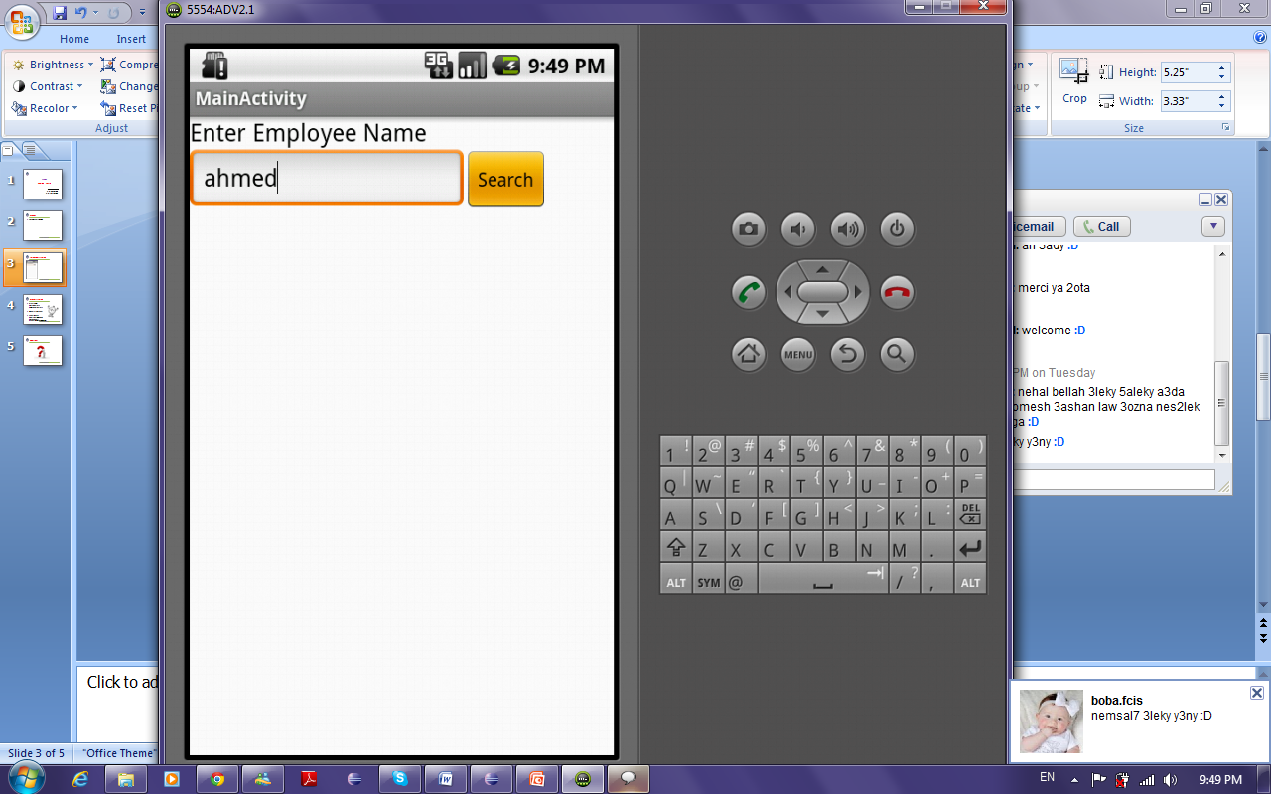
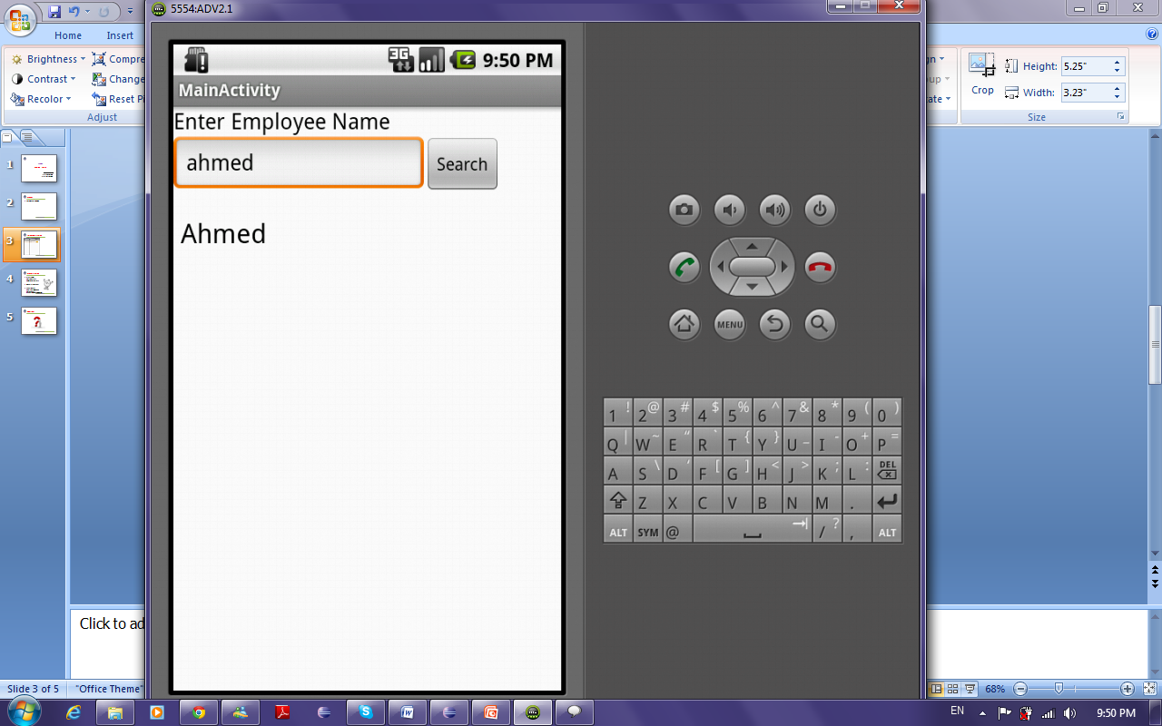
Assignment: Employees Example

Slide 18
Requirements
Scenario:
User enters a name in the edit text.
Press search button.
Then all employees that their names contain the entered name are displayed in the list by their name that is stored in the database.
The database contains two tables:
Employee
Department

Slide 19
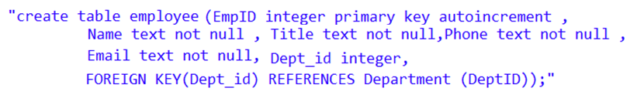
Requirements Cont’
There is a 1-m relation between the tables.
Department table creation statement
Employee table creation statement

Slide 20
Requirements Cont’
The database must contain data at the beginning so in the onCreate method, after creating the database (executing the two SQL statements previously discussed) insert some rows using ContentValues.
In the onUpgrade method, drop the two tables.
Define “getEmployees” method that takes a string name, searches for all employees that their names contain the passed name and returns a cursor.

